Slide 1
Coding History On The Streets
Dr Jon Nicholson
Hastings Creative Spring 2019

Slide 2
In this session…
Building content for the web
What is this HTML5 thing anyway?
Headings, paragraphs, media and hyperlinks
Putting content on the map
How does your phone know where you are?
Google Maps

Slide 3
Building content for the web

Slide 4
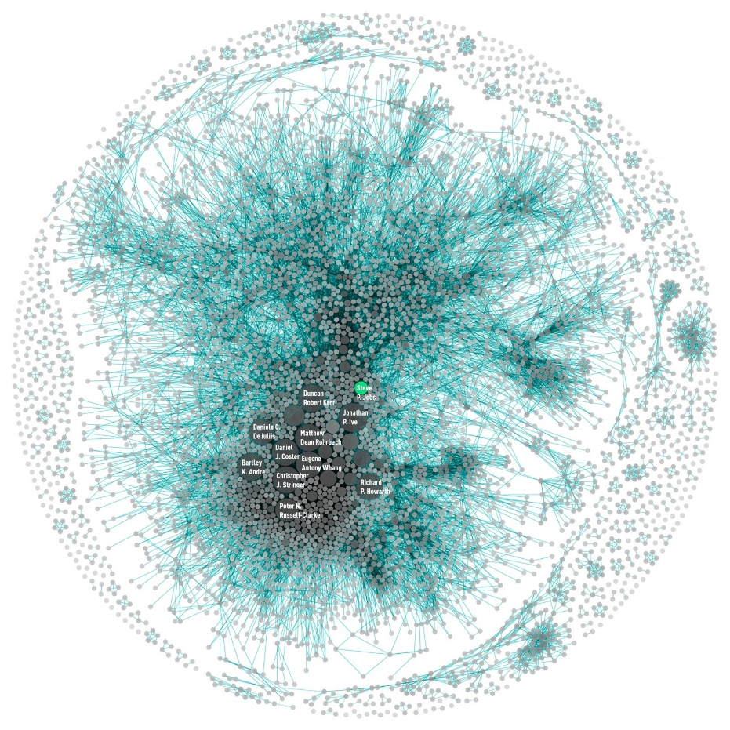
Hypertext Markup Language (HTML)
The web today is multimedia, but TEXT still important
Text on the web = HYPERTEXT
Hypertext = nodes of textual content connected by anchors / links to other nodes
Non-linear mode of presenting information
May be many different possible routes through a text
Reader has choice about which routes to follow
Reader can jump from one chunk of text to another
potentially be confusing and disorienting
Writing for the web means writing hypertext
This is different to writing ‘flat’ text

Slide 5
A basic Page
<!DOCTYPE html>
<html>
<head>
<title>PAGE TITLE</title>
</head>
<body>
<!– You put content here! -->
</body>
</html>

Slide 6
Headings and Content
HTML has 6 levels of headings:
And a content is most simply presented in paragraphs:
<h1 id="title">I’m most important</h1>
<h2>I’m not as important</h2>
…
<h6>I’m kinda important?</h6>
<p>I’m a sentence. I’m another sentence.</p>
<p>I’m a sentence in another paragraph.</p>

Slide 7
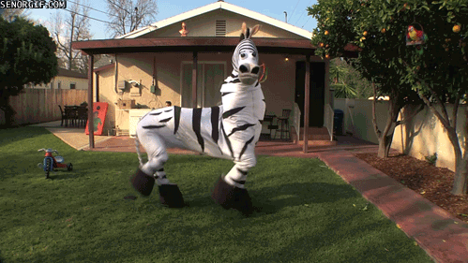
Images
Images are a great way to make a point
But can be over used
HTML has the <img> element
A src (source) attribute says what to display
Size can be controlled with width and height attributes
<img src="https://gph.is/2gOI889" height="270" width="480" />

Slide 8
Hypertext links (HyperLinks)
Hyperlinks are the simplest way to navigate a website
Text is marked up as a link using the <a> tag
A href (hypertext reference) attribute points to a target (e.g. another page)
A hyperlink is a call to action
Links should provide some information when read out of context
Links should explain what it offers / what will happen
Don't make a link that says Click here – we know this!
<a href="https://www.drjonnicholson.com">Jon’s website</a>
<a href="#title">Go back to the beginning</a>

Slide 9
Writing for humans
A study in 1997 looked at how people read web pages – they don’t
79% of readers quickly scan pages, assessing content for its relevance
People are 3 times more likely to read a summary rather than the whole page
They skip about 25% of text
If readers don’t find what they want in 10 secs they leave the site

Slide 10
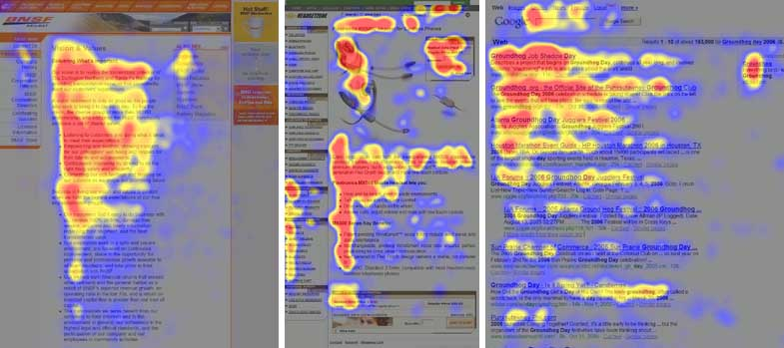
Writing for humans
The study used eye tracking technology to record how users scanned a page
Users quickly read web pages in an F-shaped pattern
1
2
3

Slide 11
recommendations
Because users read differently, we should write differently for the web
Informative text should be highly scannable
Highlight keywords - hypertext links serve as one form of highlighting
You can also <b>bold</b> and <em>emphasise</em> text
Meaningful headings
not "clever" ones
Bulleted lists
One idea per paragraph
People will skip stuff that they are not hooked by the first few words in the paragraph
Half the word count (or less) than conventional writing

Slide 12
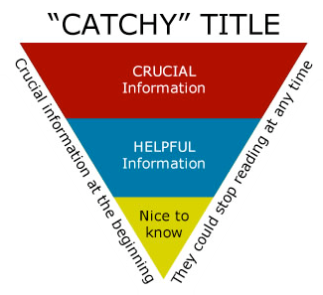
The Inverted Pyramid
Much conventional writing uses a pyramid
Progress to the conclusion after laying a foundation of problem statement, literature, method, discussion of findings etc.
The inverted pyramid style is used by newspapers
State conclusion first to grab attention
Then state the main points
Then the full story

Slide 13
Try it yourself
Create a new text file in Notepad++
Save it to your desktop as “creative.html”
Double click on it and it’ll open in your browser
Why not make a page about what you’ve done this week? Or a story?
<!DOCTYPE html>
<html>
<head>
<title>My awesome page!</title>
</head>
<body>
<h1 id="title">My Page</h1>
<p>Write some content. Make something <b>bold</b> or even
<b><em>bold and emphasised!</em></b></p>
<p>And try adding a <a href="https://giphy.com">link to something cool</a></p>
<p>And try adding images too:</p>
<img src="https://gph.is/2gOI889" height="270" width="480" />
</body>
</html>

Slide 14
Putting content on the map

Slide 15
Where are you?
There are four common methods of determining your location:
GSM localization
WiFi-based Positioning System (WPS)
Global Positioning System (GPS)
Assisted GPS (AGPS)
We’ll take a quick look at the first 3
Which your phone uses depends on your device, and the environment
They are commonly referred to as "location services"

Slide 16
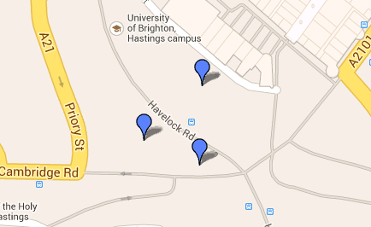

GSM localization
Battery | Low
Precision | Tens of meters
Connectivity | GSM network

Slide 17
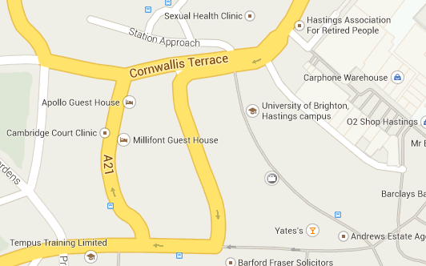
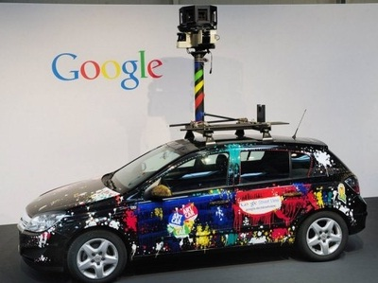
WiFi-based positioning system (WPS)
Private WiFi
Battery | High
Precision | ~1m-20m
Connectivity | WiFi
UoB
Wetherspoons
Nero
Wardriving needed

Slide 18
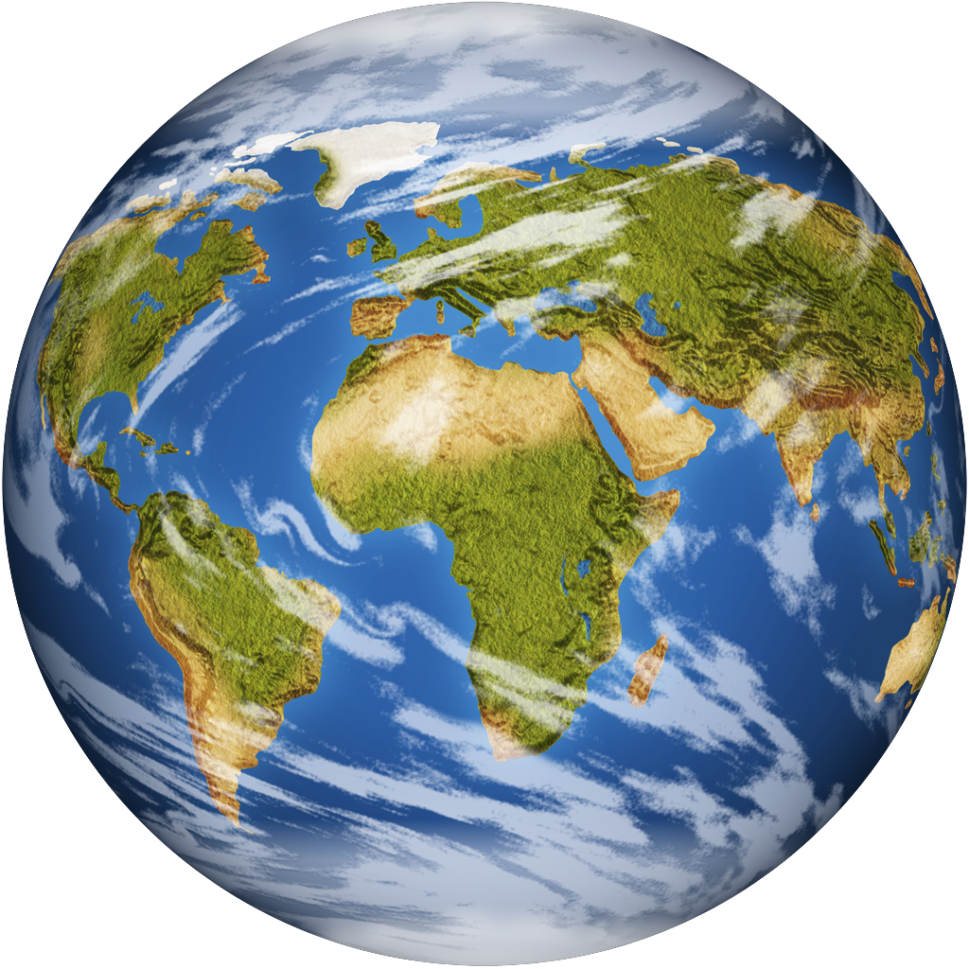
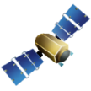
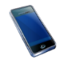
Global Positioning System (GPS)
Battery consumption | Very high
Precision | ~1m-20m (consumer)
Connectivity | None
24 satellites orbiting the Earth
Between 4 and 8 visible at any time assuming no obstructions
4 satellites required to calculate both position and height

Slide 19
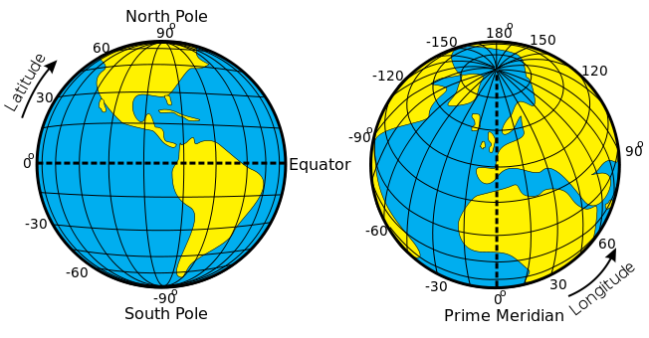
World Geodetic System
Models the earth as an ellipsoid
This is used as a reference from which positions are calculated
The origin of the model is based on the worlds centre of mass

Slide 20
Privacy
Location data is highly sensitive
Your location is being tracked minute by minute
By your mobile phone company
By the application you’re using
By the site you are visiting
https://www.ted.com/talks/malte_spitz_your_phone_company_is_watching
Malte Spitz, TED Global, 2012
If a site/app asks for your location, consider saying no

Slide 21
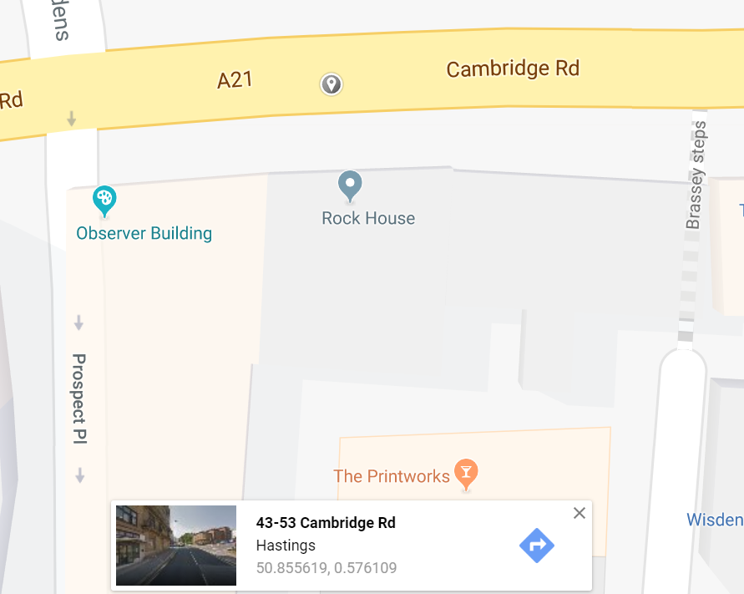
Try it yourself
Lets look at Google Maps
https://www.google.com/maps
Try clicking on a location
See the latitude and longitude?
We can make links to maps
https://developers.google.com/maps/documentation/urls/guide
Add links to your story to maps
We could do more, but maybe another day…
Embedding a map https://developers.google.com/maps/documentation/maps-static/intro
Make them look snazzy https://snazzymaps.com

Slide 22
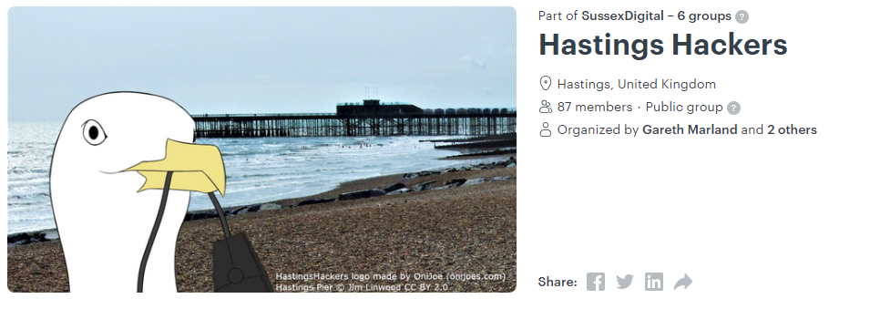
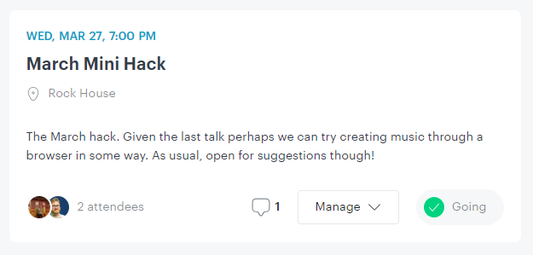
Thanks!

